Slide 1


Wim van der Plas
wvdplas@ppid.nl
10 November 2023

Slide 2

Executive Summary
In this project it is proven that with use of historic data on SpaceX launches and data science techniques, it is possible to get insight on which combinations of launch site, payload mass and booster type can maximize the chance on a successful landing of the first stage of a rocket.
This insight can be used in setting the commercial price of a customer launch request. When there is a big chance on success, the price can be sharp. When the successful landing is questionable, the price should be realistic.
In the sales process, the sales team should consult the data science team to help in determining the success rates before sending commercial proposals to customers.

Slide 3
Outline
Executive Summary
Introduction
Methodology
Results
Conclusion
Appendix

Slide 4
Introduction
SpaceX, the company of well-known founder Elon Musk, advertises Falcon 9 rocket launches on its website with a cost of 62 million dollar. Although this is a considerable amount of money, it is relatively inexpensive compared to competitors. Their launches cost up to 165 millions.
Much of the savings is accomplished because SpaceX can reuse the first stage. This will only be with a controlled landing of the first stage. And this is not with all missions. Therefore if we can determine if the first stage will land, we can determine the cost of a launch.
In this project we will use data science techniques to determine the key factors that influence the chance of a successful landing of the first stage of a rocket.
Main question to answer is which factors help in predicting a successful landing of the first stage.

Slide 5

Section 1

Slide 6
Methodology
Executive Summary
Data collection methodology:
Data has been retrieved from Spacex sources describing the specifications of launches in the past
WIKI pages have been used to retrieve data from tables on web pages
Perform data wrangling
Handle missing values, prepare high-level insights and prepare data for further analysis
Perform exploratory data analysis (EDA) using visualization and SQL
Perform interactive visual analytics using Folium and Plotly Dash
Perform predictive analysis using classification models
With the retrieved data, prediction models of different types have been trained, optimized and ranked on their accuracy

Slide 7
Data Collection
During the project we have used different techniques to gather data about finished launch missions:
Using API requests: returned JSON format results will be converted to a data frame to be analyzed
Using web scraping: data on Wiki pages related to Falcon 9 launches will be parsed to a data frame for analysis and visualization
Flowcharts of the two types of data gathering follow in the next slides.

Slide 8
Data Collection – SpaceX API
In this step I have worked on retrieving data from the supplied end point. The result has been formatted from JSON to a Pandas Data frame.
Supplied functions have been used to enrich the data with BoosterVersion, Launch site and Payload data.
And as final step I have solved the issue with missing values for Payload mass (substituted with mean value)
End point
https://api.spacexdata.com/v4/launches/past
API GET Request
JSON result
Normalize method
Data frame
GitHub URL of the completed SpaceX API calls notebook:
https://github.com/WimvanderPlas/DataScienceCourse/blob/main/jupyter-labs-spacex-data-collection-api.ipynb

Slide 9
Data Collection - Scraping
Using WIKI pages with information on Falcon 9 launches, I have created a BeautifulSoup object. Filtering the object on specific tables, I have filled a Pandas data frame containing Falcon 9 launch records.
WIKI pages
https://en.wikipedia.org/w/ index.php?title=List_of_Falcon_9_and_Falcon_Heavy_launches&oldid=1027686922
request.get() and create
BeautifulSoup object
find_all('table')
HTML tables
parsing
Data frame
GitHub URL of the completed web scraping notebook:
https://github.com/WimvanderPlas/DataScienceCourse/blob/main/jupyter-labs-webscraping(1).ipynb

Slide 10
Data Wrangling
CSV data has been loaded in a data frame for analyzing:
percentage missing values in columns
number of launches per site
the number and occurrence of each orbit type
the number and occurrence of mission outcome per orbit type
CSV file
pd.read_csv()
Raw Dataframe
added column [Class]
Refined Dataframe
Finally I added a column Class to the data frame which represents the landing outcome
GitHub URL of the completed data wrangling notebook:
https://github.com/WimvanderPlas/DataScienceCourse/blob/main/labs-jupyter-spacex-Data_wrangling.ipynb

Slide 11
EDA with Data Visualization (1)
In this chapter, several charts have been plotted to explore relationships between characteristics of a launch and the landing outcome. These relationships will help in predicting whether a launch will be successful or not.
Charts plotted:
FlightNumber vs. PayloadMass
FlightNumber vs. LaunchSite
PayloadMass vs. LaunchSite
Success rate of each Orbit type
FlightNumber vs. Orbit type

Slide 12
EDA with Data Visualization (2)
Charts plotted (continued):
PayloadMass vs. Orbit type
Launch success yearly trend
And as last steps, in preparation of setting up a predictive analysis model, features have been selected that affect the success rate and OneHotEncoding has been applied to them.
GitHub URL of the completed EDA with data visualization notebook:
https://github.com/WimvanderPlas/DataScienceCourse/blob/main/jupyter-labs-eda-dataviz.ipynb

Slide 13
Build an Interactive Map with Folium
In this part three tasks have been executed:
Create a Folium map with circles and markers for each launch site. This to visualize where the launch sites are located on the continent
Mark the success/failed launches for each site. The added markers and green/red colour give insight on the success rate per location
Calculate the distances between a launch site and its proximities. For site VAFB SLC-4E lines have been added to coast line and nearest highway, railway and city, including a marker showing the distance in km. The added info gives information on considerations where to build a launch site.
GitHub URL of the completed interactive map with Folium notebook:
https://github.com/WimvanderPlas/DataScienceCourse/blob/main/lab_jupyter_launch_site_location.jupyterlite.ipynb

Slide 14
EDA with SQL (1)
Queries performed in this chapter:
Display the names of the unique launch sites in the space mission
SELECT DISTINCT Launch_site FROM SPACEXTABLE
Display 5 records where launch sites begin with the string 'KSC'
SELECT * FROM SPACEXTABLE WHERE Launch_site like 'KSC%' LIMIT 5
Display the total payload mass carried by boosters launched by NASA (CRS)
SELECT SUM(PAYLOAD_MASS__KG_) from SPACEXTABLE WHERE Customer = 'NASA (CRS)'
Display average payload mass carried by booster version F9 v1.1
SELECT AVG(PAYLOAD_MASS__KG_) from SPACEXTABLE WHERE Booster_Version = 'F9 v1.1'
List the date where the succesful landing outcome in drone ship was acheived.
SELECT MIN(DATE) from SPACEXTABLE WHERE Landing_Outcome = 'Success (drone ship)'
List the names of the boosters which have success in ground pad and have payload mass greater than 4000 but less than 6000
SELECT Booster_Version from SPACEXTABLE WHERE Landing_Outcome = 'Success (ground pad)' AND PAYLOAD_MASS__KG_ > 4000 AND PAYLOAD_MASS__KG_< 6000

Slide 15
EDA with SQL (2)
List the total number of successful and failure mission outcomes
SELECT Mission_Outcome , Count(Mission_Outcome) from SPACEXTABLE GROUP BY Mission_Outcome
List the names of the booster_versions which have carried the maximum payload mass.
SELECT Booster_Version, PAYLOAD_MASS__KG_ from SPACEXTABLE WHERE PAYLOAD_MASS__KG_ = (SELECT MAX(PAYLOAD_MASS__KG_) from SPACEXTABLE)
List the records which will display the month names, succesful landing_outcomes in ground pad, booster versions, launch_site for the months in year 2017
SELECT Booster_Version, PAYLOAD_MASS__KG_ from SPACEXTABLE WHERE PAYLOAD_MASS__KG_ = (SELECT MAX(PAYLOAD_MASS__KG_) from SPACEXTABLE)
Rank the count of landing outcomes (such as Failure (drone ship) or Success (ground pad)) between the date 2010-06-04 and 2017-03-20, in descending order
SELECT Landing_Outcome, COUNT(Landing_Outcome) as Number FROM SPACEXTABLE WHERE Date BETWEEN '2010-06-04' AND '2017-03-20' GROUP BY Landing_Outcome ORDER BY Number DESC
GitHub URL of the completed EDA with SQL notebook:
https://github.com/WimvanderPlas/DataScienceCourse/blob/main/jupyter-labs-eda-sql-edx_sqllite.ipynb

Slide 16
Build a Dashboard with Plotly Dash (1)
The dashboard built in this topic consists of two parts:
A site selection box with a pie chart. If "All sites" is selected, the pie chart shows the Total success launches per Site. When a specific site is selected in the selection box, the pie chart shows the successful and unsuccessful launches of that site.
A callback function was added to redraw the pie chart on each change in the site selection.

Slide 17
Build a Dashboard with Plotly Dash (2)
The other part is a scatter plot showing the relation between Payload Mass and Succes. The scatter plot takes the site selection in account. And the dots in the plot are given a unique color representing the Booster Version Category. In the scatter plot there is also a slider added to narrow the range of payloads shown in the plot.
A callback function was added to redraw the scatter plot on each change in the site selection or payload mass.
The pie and scatter plot help in the decision from which site, with which booster version a certain payload should be launched to have the best chance on a successful landing of the first stage.
GitHub URL of the completed Plotly Dash lab:
https://github.com/WimvanderPlas/DataScienceCourse/blob/main/spacex_dash_app%20final.py

Slide 18
Predictive Analysis (Classification)
The CSV launch data loaded from the SN website was loaded into a data frame. The data frame was loaded into a NumPy array.
The data in the NumPy array was standardized and split into training data and test data.
After that the train data has been used to train different classification models (Logistic Regression, Support Vector Machine, Decision Tree, K Nearest Neighbour) . For each model GridSearch was used to find the optimal hyperparameters set.
For the optimized model the accuracy was calculated and a confusion matrix was plotted using the test
data
Load data
Training data
Train model
Optimized model
Accuracy / conf.matrix
Test data
GitHub URL of the completed predictive analysis lab notebook:
https://github.com/WimvanderPlas/DataScienceCourse/blob/main/SpaceX_Machine_Learning_Prediction_Part_5.jupyterlite.ipynb

Slide 19
Results
Exploratory data analysis results
Interactive analytics demo in screenshots
Predictive analysis results

Slide 20

Section 2

Slide 21
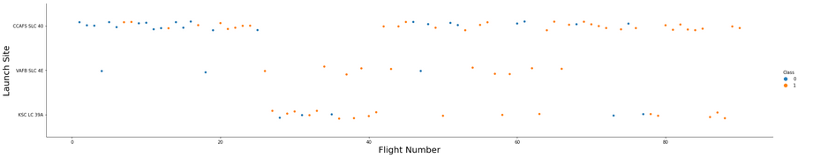
Flight Number vs. Launch Site
On the picture above, you can see a scatter plot of Flight Number vs. Launch Site
Looking at the plot it is clear that each launch site develops greater success (orange dots) numbers as the flight numbers increase. VAFB has developed a greater chance on success earlier in time. KSC is very successful in flight numbers from about 40 on.

Slide 22
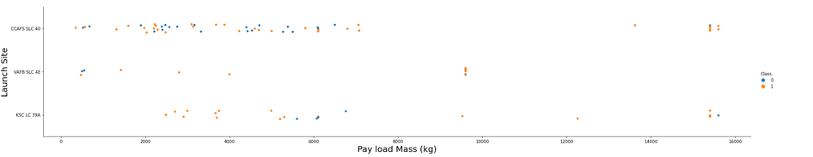
Payload vs. Launch Site
Looking at a scatter plot of Payload vs. Launch Site you can see that two of three launch-site have a payload range where the chance of successful first stage landings is more likely. For example the KSC LC-39A site is highly successful in the payload range until 5500 kg and from 9500 kg on. The VAFB SLC-4E has a flawless record from 1950 kg on. And CCAFS SLC-40 has its best range in 7000 kg payloads and higher.

Slide 23
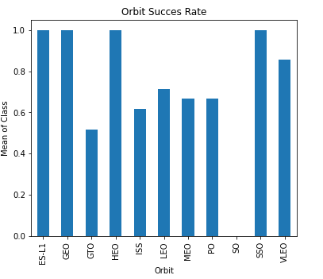
Success Rate vs. Orbit Type
The bar chart on the left shows the mean success rate of each orbit type.
ES-L1, GEO, HEO and SSO have the highest success rates. Rates being a mean of 1 gives full confidence for reusability of stage 1.

Slide 24
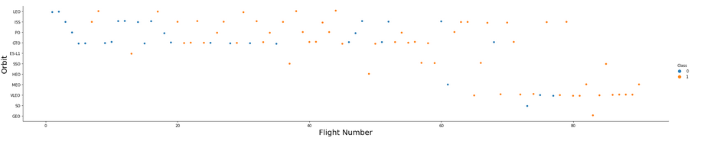
Flight Number vs. Orbit Type
In the scatter plot on this page, showing the relationship between Flight Number and Orbit type, there is no clear trend. You can see that as Flight numbers increase, there is a bigger chance on success. But that was already a conclusion on the plot of Flight Number vs. Launch Site slide.

Slide 25
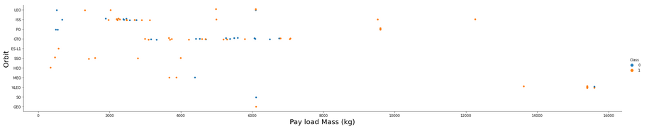
Payload vs. Orbit Type
With heavy payloads the successful landing rate is higher for Polar, LEO and ISS.
For GTO it is hard to see a relationship; both positive landing rate and negative landing (unsuccessful missions) are both there.

Slide 26
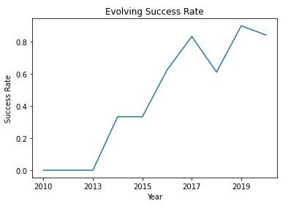
Launch Success Yearly Trend
In the line chart of yearly average success rate, you can see that between the years 2013 and 2017 there has been an increasing trend in the success rate with 2014 as steady rate year.
In 2018 there has been a temporary drop in the trend, increasing again in 2019. But the trend is broken again towards 2020.
Conclusion is that the steady increase until 2017 is discontinued in the years after. However, the success rate nowadays is high.

Slide 27
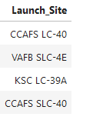
All Launch Site Names
I have used the following query to display the names of the unique launch sites in the space mission:
SELECT DISTINCT Launch_site FROM SPACEXTABLE
The query result is:

Slide 28
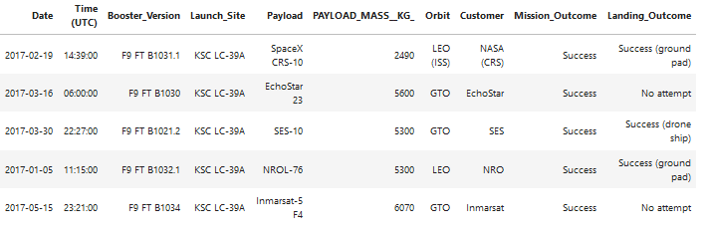
Launch Site Names Begin with 'KSC'
For finding 5 records where the launch sites’ names starts with `KSC`, I have used the query:
SELECT * FROM SPACEXTABLE WHERE Launch_site like 'KSC%' LIMIT 5
The LIMIT parameter tailors the output of the query to not more than 5 lines. The query result is as follows:

Slide 29
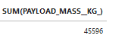
Total Payload Mass NASA
Summarizing the total payload that was carried for customer NASA, was done using the query:
SELECT SUM(PAYLOAD_MASS__KG_) from SPACEXTABLE WHERE Customer = 'NASA (CRS)'
The query result (meaning that over 45 tons of load was carried for this specific customer) is:

Slide 30

Average Payload Mass by F9 v1.1
To calculate the average payload mass carried by booster version F9 v1.1, I used the query:
SELECT AVG(PAYLOAD_MASS__KG_) from SPACEXTABLE WHERE Booster_Version = 'F9 v1.1'
The query result shows that for this specific booster type, the load of all launches summarized and divided by the number of flights, gives an average of almost 3 tons.

Slide 31
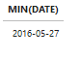
First Successful Ground Landing Date
For finding the date of the first successful landing outcome on a drone ship, I have selected all the lines with "Success (drone ship)" as landing outcome, and in this set determined the earliest date with the MIN(DATE) parameter.
SELECT MIN(DATE) from SPACEXTABLE WHERE Landing_Outcome = 'Success (drone ship)'
Result of the query shows that on the 27th of May in 2016 the first successful drone ship landing has been made.

Slide 32
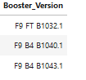
Successful Drone Ship Landing with Payload between 4000 and 6000
The assignment to list the names of boosters which have successfully landed on a drone ship and had payload mass greater than 4000 but less than 6000, was solved using query:
SELECT Booster_Version from SPACEXTABLE WHERE Landing_Outcome = 'Success (ground pad)' AND PAYLOAD_MASS__KG_ > 4000 AND PAYLOAD_MASS__KG_< 6000
Using the load boundaries and the landing outcome status, gives the results for the following booster types:

Slide 33
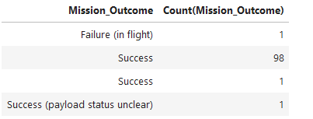
Total Number of Successful and Failure Mission Outcomes
In order to calculate the total number of successful and failure mission outcomes, I have ran the following query:
SELECT Mission_Outcome , Count(Mission_Outcome) from SPACEXTABLE GROUP BY Mission_Outcome
All rows have been grouped based on the value of the column Mission_Outcome and the and he rows in a group have been counted. The result is shown below.

Slide 34
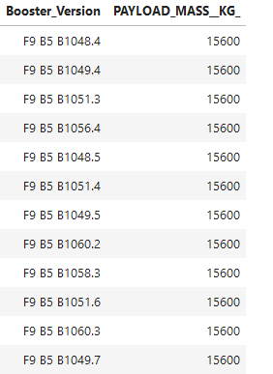
Boosters Carried Maximum Payload
Assignment was to list the names of the boosters which have carried the maximum payload mass. The following query was run:
SELECT Booster_Version, PAYLOAD_MASS__KG_ from SPACEXTABLE WHERE PAYLOAD_MASS__KG_ =
(SELECT MAX(PAYLOAD_MASS__KG_) from SPACEXTABLE)
With a subquery the maximum payload in the table was
retrieved and in the query the booster versions that
have carried this payload have been selected.

Slide 35
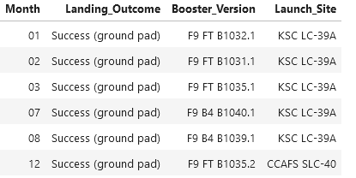
2017 Launch Records
In order to list the records which will display the month names, successful landing outcomes in ground pad, booster versions and launch site for the months in year 2017, I have setup the query:
SELECT substr(Date,6,2) as Month, Landing_Outcome, Booster_Version, Launch_Site from SPACEXTABLE WHERE substr(Date,0,5) ='2017' AND Landing_Outcome = 'Success (ground pad)' ORDER BY Month
With the substr statement, specific parts of the date string have been set for selecting records and displaying the results. Query result is:

Slide 36
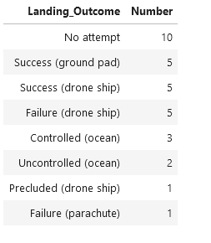
Rank Landing Outcomes Between 2010-06-04 and 2017-03-20
For the assignment to rank the count of landing outcomes (such as Failure (drone ship) or Success (ground pad)) between the date 2010-06-04 and 2017-03-20, in descending order, the following query has been setup:
SELECT Landing_Outcome, COUNT(Landing_Outcome) as Number FROM SPACEXTABLE WHERE Date BETWEEN '2010-06-04' AND '2017-03-20' GROUP BY Landing_Outcome ORDER BY Number DESC
With the date boundaries, grouping by landing outcome and ordering by the number for that group in descending order, the following subset on the right was selected:

Slide 37

Section 3

Slide 38
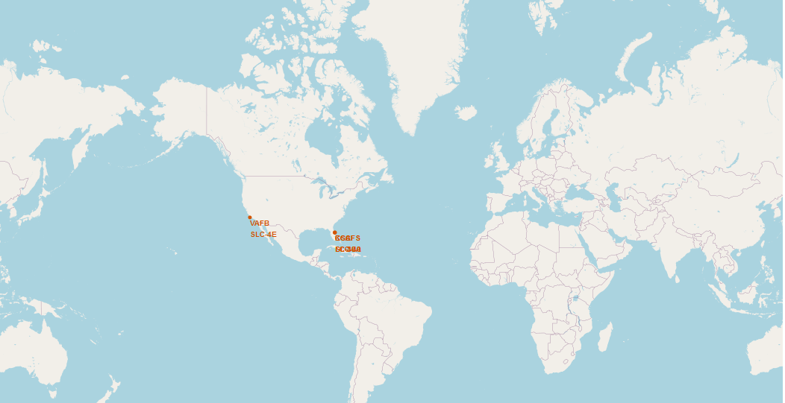
Map with all launch sites (1)
Using Folium a map was made with markers for all SpaceX launch sites. The results is as follows:

Slide 39
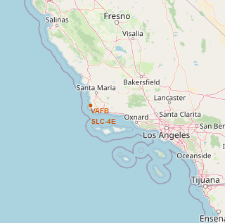
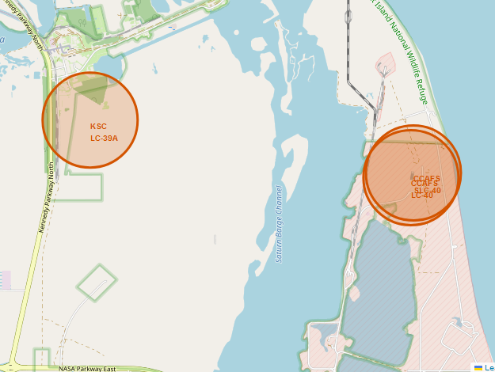
Map with all launch sites (2)
Because the launch sites on a global scale map are hard to distinguish, a zoomed in map of west coast and east coast launch sites is added:
Findings on the screenshot:
The Florida launch sites are the closest to the equator line. All launch sites are in very close proximity to the coast. VandenBerg is on the West coast, the other three are on the East coast
Launching from a location near the equator, the object gets the advantage of the earth's spinning speed.
The earth is turning in East direction. Launching from the East coast gives the space aircraft an additional boost due to the rotational speed of Earth.
Launching from the Eastern location in Eastward direction the object will be flying over the ocean. If anything might go wrong, it is likely that the object or parts of the object will land in the sea.

Slide 40
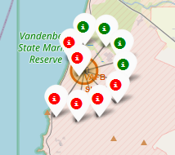
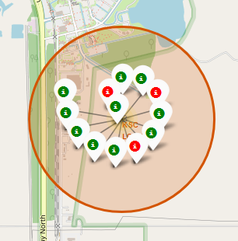
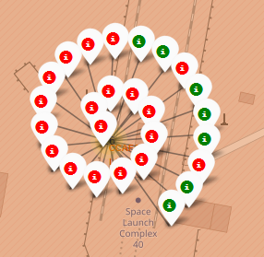
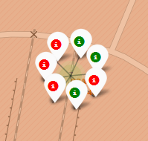
Launch outcome per site
Using markers with a red or green color, representing a successful or unsuccessful landing, insight has been created on how successful a site is.
VAFB SLC-4E
KSC LC-39A
CCAFS LC-40
CCAFS SLC-40
Looking at the markers, it is clear that the KSC LC-39A site has the highest success rate.

Slide 41
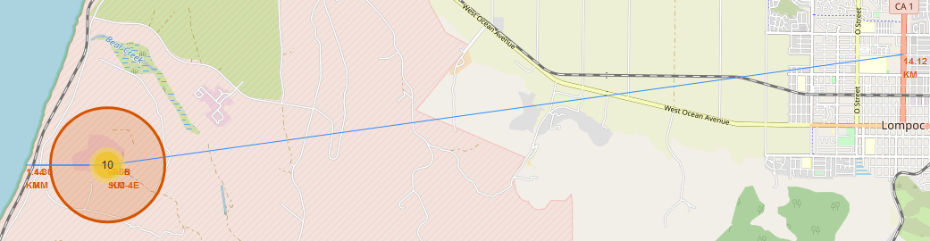
Explore launch site surroundings
For one launch site, VAFB SLC-4E, the Folium map has been extended with markers and distance indicators for coast line, closest highway, closest railway and nearest city:
Launch sites are in close proximity to railways, highways and coastline. Being close to railways and highways has advantages on logistics. Rockets, payload, parts and supporting goods need to be transported to the launch site. The proximity to coastline has safety advantages. The sooner a missile is away from inhabited area the better it is in case of issues. Launch sites keep a certain distance away from cities for the same safety reasons mentioned for coastline proximity.

Slide 42

Section 4

Slide 43
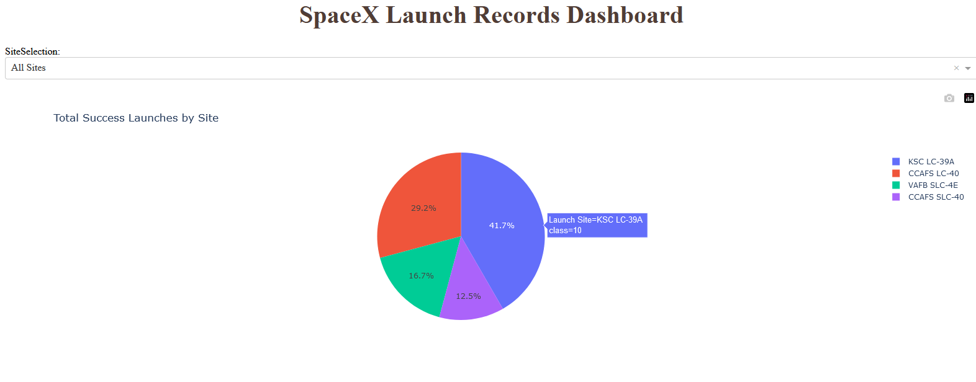
Launch Success counts for all sites
The pie chart below shows the launch success count for all sites, giving the share in the total for each site as a percentage.
From the figure it is clear that the largest contribution in successful launches is made by the site KSC LC-39A (10 times)

Slide 44
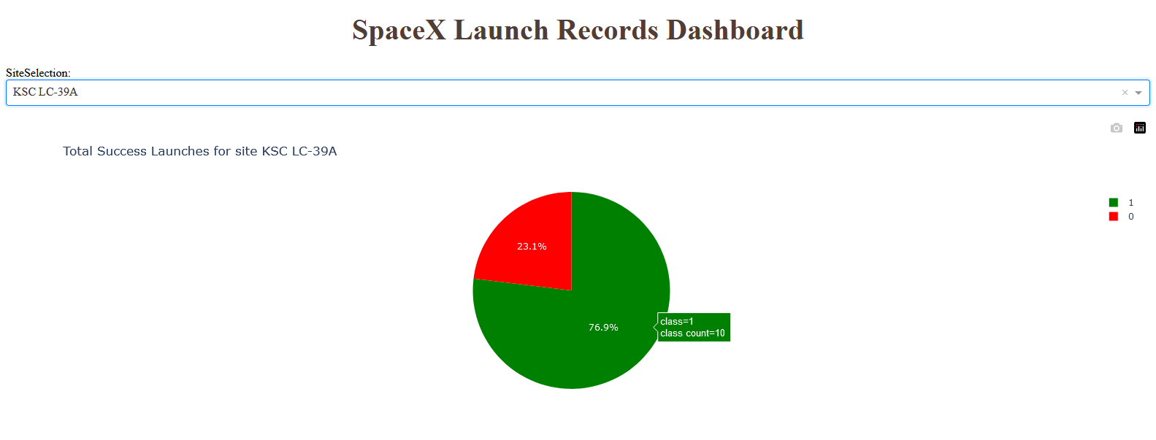
Most successful launch site
With the selection box connected to the displayed pie chart, it is possible to select the launch site with the highest success rate.
In this situation the most successful site is KSC LC-39A. It not only has the nominal advantage compared to other sites, but also the ratio between success and failure is best for this site. A percentage of 76.9 to be precise.

Slide 45
Payload vs. Landing Outcome plot (1)
Using the payload range slider, you can get insights on the relation between Payload and Landing Outcome. Each time the range slider is adjusted, the scatter plot will be redrawn (because of the callback function in the code).
It is hard to show all combinations of Payload, Booster type and Success, so the most interesting I have seen have been selected for this presentation:
Unfiltered: all payloads, all boosters
Payloads < 5000 kg, booster type v1.1
Payloads between 2000 kg and 5500 kg, booster type FT

Slide 46
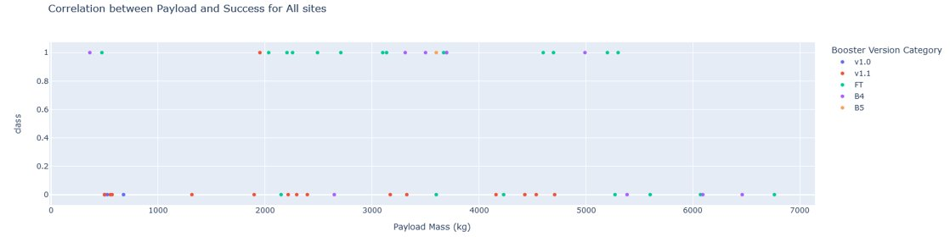
Payload vs. Landing Outcome plot (2)
Unfiltered: having all launches plotted, it is clear that there are successful payload ranges and unsuccessful ranges. For example:
Payloads < 500 kg (however small in number) have always been successful
In the range between 1900 and 4000 kg the bigger part of the launches were successful
In the rage between 4000 and 5300 kg, the bigger part is unsuccessful
In the range over 5300 kg, there is not a single successful landing outcome

Slide 47
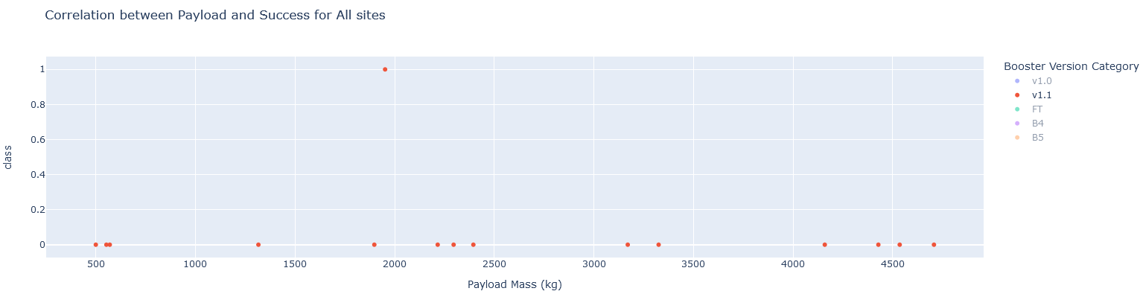
Payload vs. Landing Outcome plot (3)
Payloads < 5000 kg, booster type v1.1 : this seems an unsuccessful combination because in the whole series of landings there was only one mission that was successful.

Slide 48
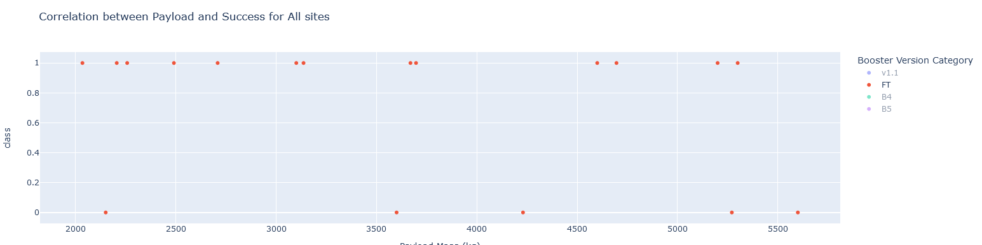
Payload vs. Landing Outcome plot (4)
Payloads between 2000 kg and 5500 kg, booster type FT:
This proves to be a successful combination. Majority of the launches had a successful landing outcome

Slide 49

Section 5

Slide 50
Classification Accuracy
For this topic, predictive models of different kinds have been made and optimized. The accuracy of the models with training and test data has been visualized in a bar chart here:
In the bar chart you can see that the test accuracy of all models is identical. There is a difference in training accuracy; the Decision Tree model performs best.

Slide 51
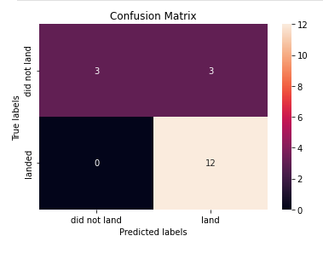
Confusion Matrix
Shown below is the Confusion matrix of the best performing model (Decision Tree):
Category of concern in the matrix are the three outcomes predicted as "land" but in true life "did not land".

Slide 52
Conclusions (1)
As the experience in launching increases over years, the success rate is also increasing. There is a learning curve.
Launch sites are in close proximity to railways, highways and coastline. Being close to railways and highways has advantages on logistics. Rockets, payload, parts and supporting goods need to be transported to the launch site. The proximity to coastline has safety advantages. The sooner a missile is away from inhabited area the better it is in case of issues. Launch sites keep a certain distance away from cities for the same safety reasons mentioned for coastline proximity.
However there are launch locations with a high success rate, my conclusion is that the success is only partly related to the location. Launching from a specific location is not a guarantee for success

Slide 53
Conclusions (2)
Choosing the right combination of Payload Mass and Booster Type is highlyimportant. For example as we have seen for masses between 2000 kg and 5500 kg. Here a combination with booster type FT is almost a guarantee for success.

Slide 54
Appendix (1)
Data sources/sets used during this project:
Website | https://en.wikipedia.org/w/index.php?title=List_of_Falcon_9_and_Falcon_Heavy_launches&oldid=1027686922
 | https://api.spacexdata.com/v4/rockets
API endpoints | https://api.spacexdata.com/v4/launches/past
 | https://api.spacexdata.com/v4/rockets
 | https://api.spacexdata.com/v4/launchpads
 | https://api.spacexdata.com/v4/payloads/
 | https://api.spacexdata.com/v4/cores/
CSV files | https://cf-courses-data.s3.us.cloud-object-storage.appdomain.cloud/IBM-DS0321EN-SkillsNetwork/datasets/dataset_part_2.csv

Slide 55
Appendix (2)
Datasets created during this project:
CSV files | https://github.com/WimvanderPlas/DataScienceCourse/blob/main/dataset_part_1.csv
 | https://github.com/WimvanderPlas/DataScienceCourse/blob/main/dataset_part_2.csv
 | https://github.com/WimvanderPlas/DataScienceCourse/blob/main/dataset_part_3.csv
 | https://github.com/WimvanderPlas/DataScienceCourse/blob/main/spacex_web_scraped.csv

Slide 56


